Slide 1
TCOO
Charging Basics

Slide 2
Charge Faster!

Slide 3
Charging Standards
Level 1
120V AC (Single Phase)
15A Circuit – 12A Max Continuous – 1.44kW
20A Circuit – 16A Max Continuous – 1.92kW
Level 2
208V – 240V AC (Single Phase)
100A Circuit – 80A Max Continuous – 19.20kW
Level 3
Tesla CHAdeMO: 400V DC – 125A – 62.5kW
Tesla Supercharger: 400V DC – 250kW

Slide 4
Onboard Charger
Model 3
Long Range 3 = 48A Max
Short / Mid Range 3 = 32A Max
Model S/X
Refresh 75kWh S/X = 48A Max
Refresh 100kWh S/X = 72A Max
Nosecone S (Single Charger) = 40A Max
Nosecone S (Dual Charger) = 80A Max

Slide 5
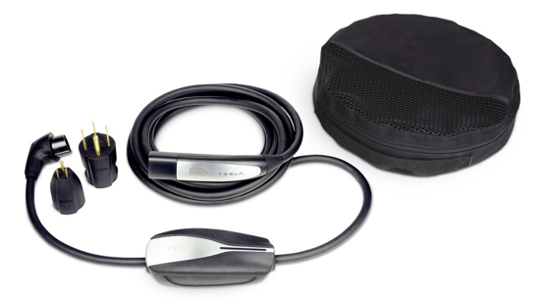
Mobile Connector (UMC)
Gen 1 -- 40A Max – 9.6kW

Slide 6
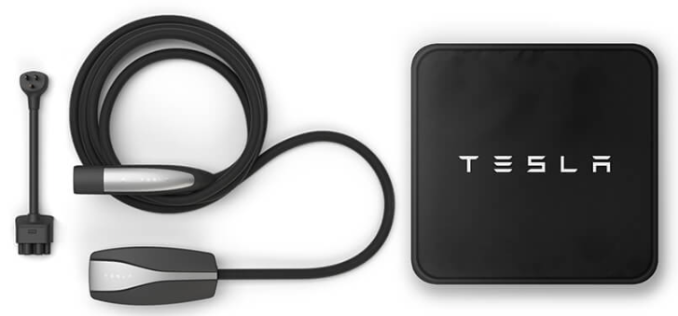
Mobile Connector (UMC)
Gen 2 – 32A Max – 7.7kW

Slide 7
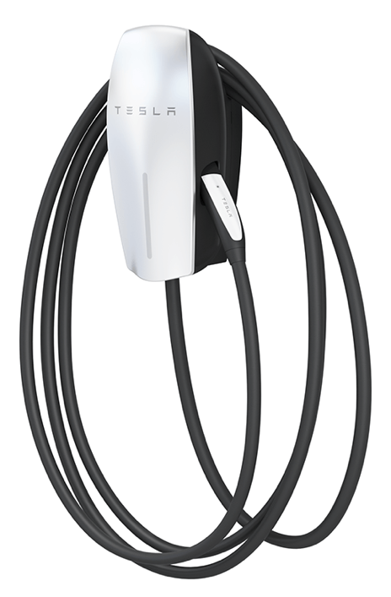
Wall Connector (HPWC)
Gen 1 & 2 – 80A Max – 19.2kW

Slide 8
J1772 Plug

Slide 9
CHAdeMO Plug

Slide 10
CCS Combo Plug

Slide 11
J1772 Adapter

Slide 12
CHAdeMO Adapter

Slide 13
Things To Consider
Caution - charging too high will reduce regenerative braking.
It is normal for the cooling fans to be loud when Supercharging.
Charging will be much slower at low & high SOC.
You will lose some charge, even when plugged-in.
Use PlugShare to find charging locations.
Charging Etiquette… a topic of it’s own.

Slide 14
Best Practices
Stay between 20% - 80%.
It’s okay to go to 10% - 90%.
Try to avoid less than 10% or more than 90%.
Charge at Level 2 if feasible.
Keep Regen at Standard.
Supercharging on trips – stay low, don’t go too high.

Slide 15
Thanks!!

